Slide 1
How I Failed To Automate Myself Out Of A Job
Dhana Kaneshayogan - Infrastructure Engineer

Slide 2
Who am I...
Network Software Engineer(?)
I break things a lot
I’m really lazy (e.g: doesn’t like typing “int vlan”)
Not very good at repetitive tasks
Linux Enthusiast

Slide 3
A long time ago...
Had a repetitive, time-consuming task
Relatively simple when it was small < 50
Didn’t scale > 100
Low confidence in ability to execute it successfully (a.k.a: low trust in confidence to execute)

Slide 4


Slide 5

Not many tools...
No (reliable) IPAM solution
No access to all routers/switches on network
No reliable documentation
Jumphost, but no root access
Can run some shell commands
.
.
.
That’s it

Slide 6

My first bash script...
In prod that is.
I’ve run several shell scripts blindly downloaded from the internet.

Slide 7
cat hosts.csv | awk '{print $1}' | xargs -n 1 ping -c 1 | grep from

Slide 8

Great, I’m not even supposed to be here today
Thought I’d get to go home early… Nope
Project finished early. Got moved to a different site.
Got tasked with office EoL replacement and upgrades instead.
Turned out to be a blessing in disguise
Used the downtime to do a Python for beginners course.
Jumped into using Netmiko/Paramiko for config replacement.

Slide 9

On to the next one...
Large ISP (e.g: upgrade upto 20 devices in a 6 hour maintenance window, wait for reconvergence of full BGP table each time)
Constant software upgrades over lots of different types of devices.
Software conversions when changing vendors.
Started to automate things like pre-post change show commands and did validation on these things.
Wrote a thing that helped people automate software conversions.

Slide 10
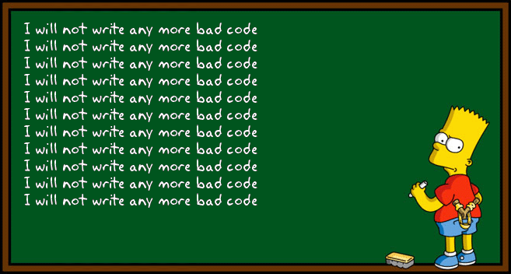
Did some horrible things along the way
if len(ip_address.split(‘.’))==4 :(
re.compile('\w+\.\w+\.\w+\.\w+')
Username = ‘username’, password = ‘password’
Lots of ‘continue’, ‘break’ statements
Never wrote a unit test
O(n**9999999999999) loops :(
‘Monkey patched’ almost every class I wrote
Mutated lists in place *all* the time
Never wrote a ‘proper’ docstring
Debugged solely using ‘print’ statements
Always used ‘file’ as a variable name :(
Got -1.69/10 using pylint

Slide 11

My Version Control

Slide 13
2016...
Went to PyCon
Had my first code review!
Decided I needed to do more automation ⇒ a.k.a Write more code
Met Andree/OpenDNS/Cisco Umbrella
They were automating everything....
Configuration management, Event driver automation, Exposing the network as an API… you name it!

Slide 14


Slide 15

Happily ever after…
Thought I would just drink coffee and reddit all day… Nope….
AWS… AWS everywhere
Writing APIs
Wrote another web app
Unit tests
Event driven automation stuff
Someone talked about building microservices the other day
Went to PyCon, and someone told me I was a developer now.

Slide 16

Cisco Cloud infrastructure Engineering
Transit Terminator
Andree Toonk
atoonk@cisco.com

Slide 17

Cloud Infrastructure that powers these numbers
145B
legitimate queries per day
90M
daily active users
16K
enterprise customers

Slide 18
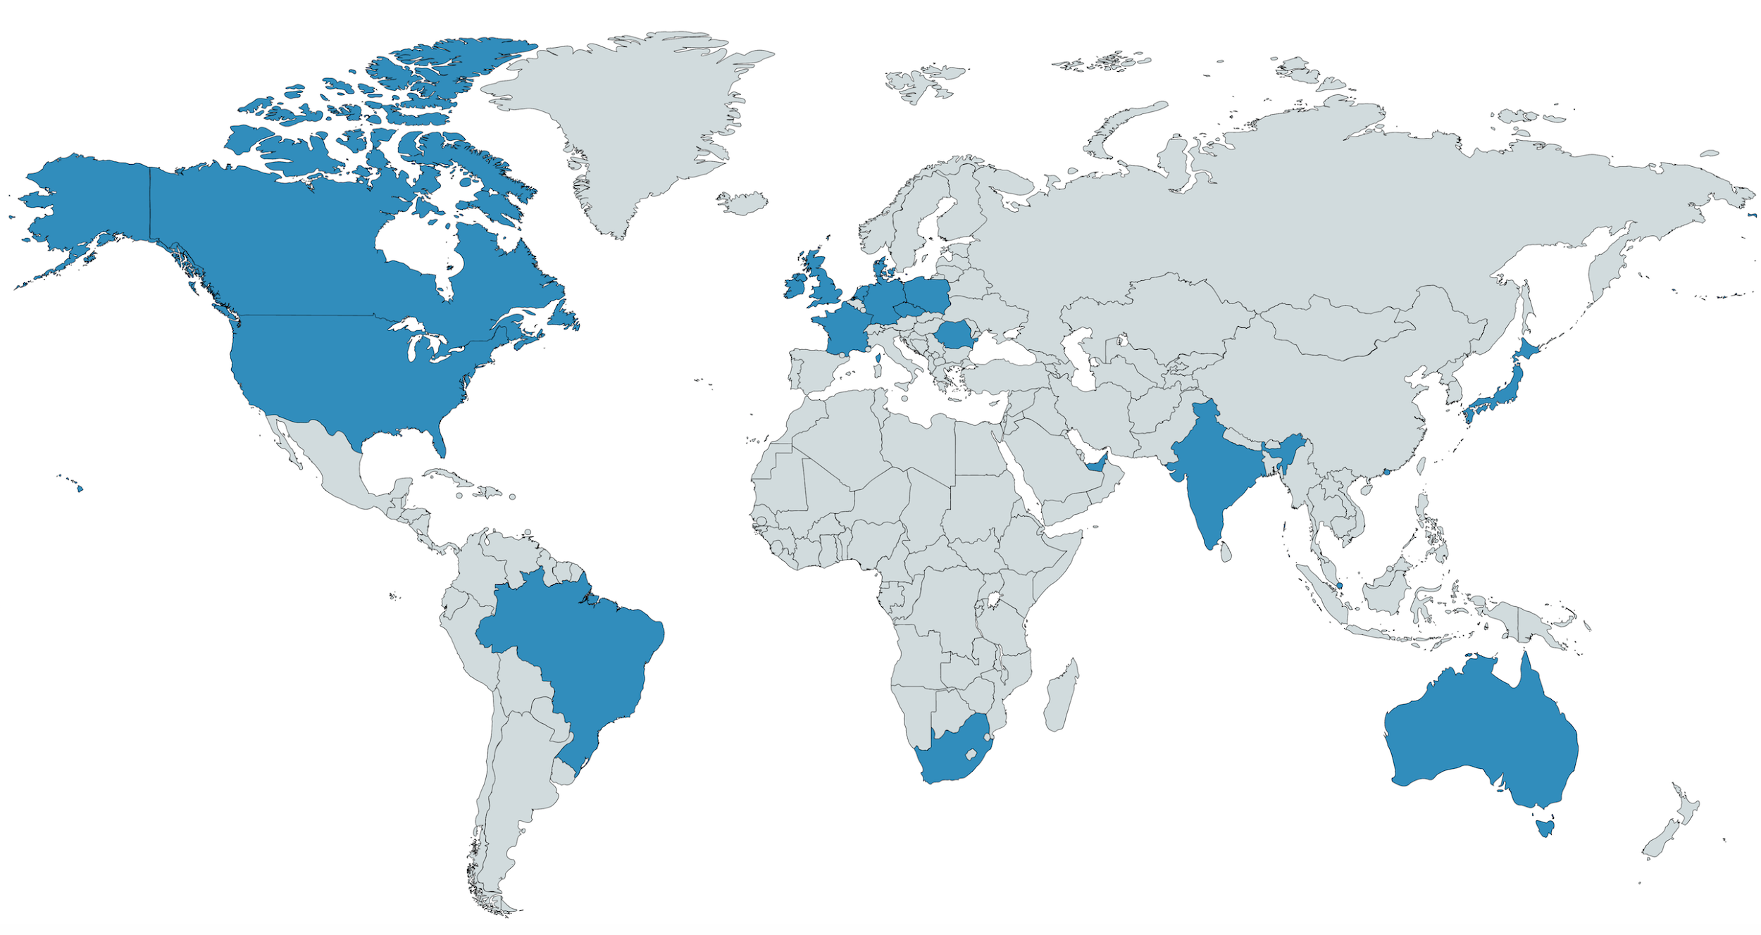
32 datacenters

Slide 19
Thousands of peering sessions at dozens of Internet Exchanges
Hundreds network devices
>100 Transit connections

Slide 20
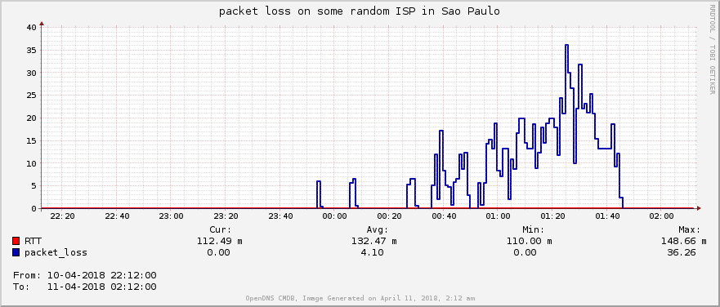
With that many external links Packet loss happens all the time

Slide 21
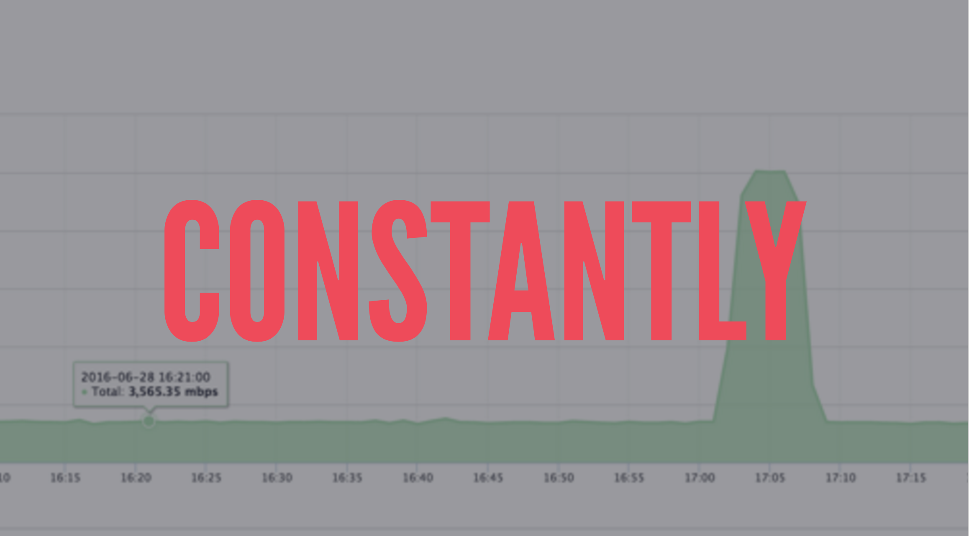

Slide 22
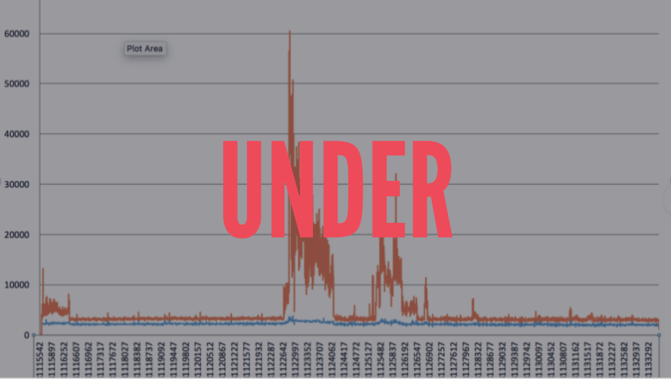

Slide 23
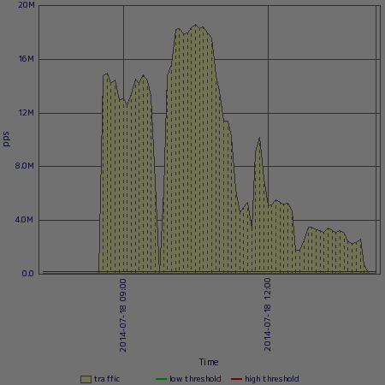
ATTACK
Notes:
20mmps at 1500 bytes = 240gbs

Slide 24

Lots of midnight pages

Slide 25

Remediation well understood and practiced a dozen times a week

Slide 26

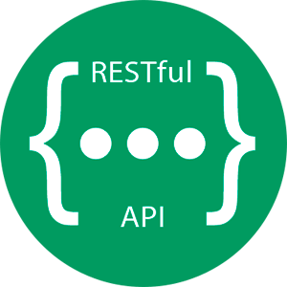
API’s for everything
/v2/list_api_tokens
/v2/network_services
/v2/ip/
/v2/asns
/v2/locations
/v2/devices
/v2/contacts
/v2/transit_sessions
/v2/peering_sessions
/v2/vpn_tunnels
/v2/checks
/v2/pollers
/etc...

Slide 27

Traffic management
When things go bad
Notes:
Number source of pages for neteng, other teams, and customer impact is network.
Neteng should make that better, make it a non issue for other teams and customers
Can we make the network selfhealing? Lot of this work came out of hackathons. let’s look at some examples.

Slide 28
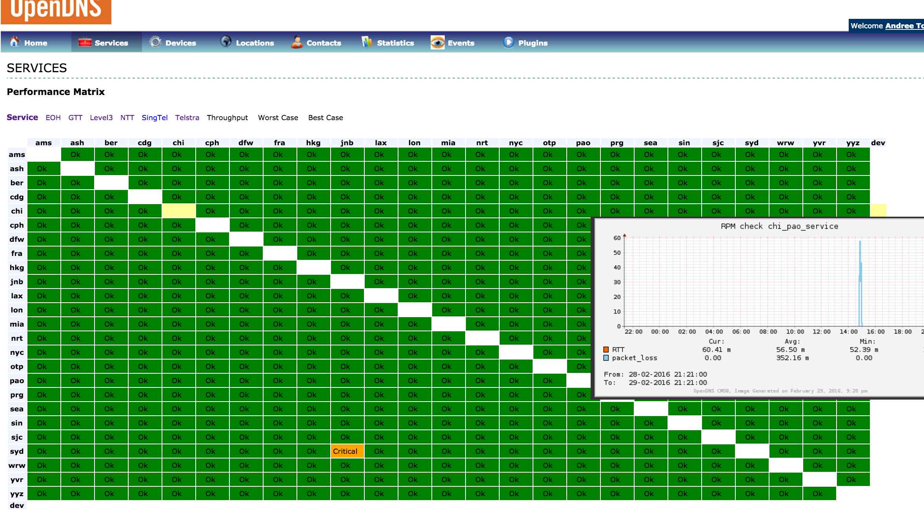

Slide 29
Transit Optimizer
San Jose 192.0.2.0/24
BGP: 203.0.113.0/24 via next hop Level3
0% loss
138ms
0% loss
156ms
15% loss
133ms
Transit Optimizer BGP speaker (Exa)
Level3
NTT
GTT
3 options between San Jose and London Level3 is the best option based on latency and packet loss measurements.
Transit optimizer send BGP updates with the prefered path
London 203.0.113.0/24
BGP: 192.0.2.0/24 via next hop Level3

Slide 30
This helps us route around packet loss between our datacenters
calculate best path between all datacenters (full mesh)
Recalculate best path every 60 seconds
update best nexthop
via BGP to all routers

Slide 31
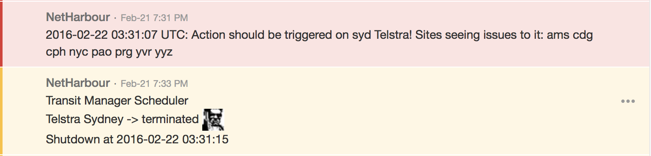
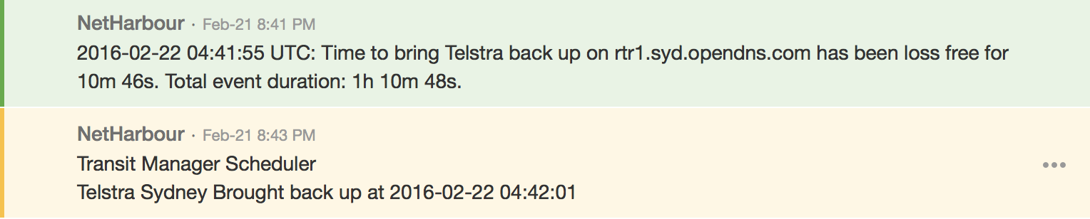
Provider experiences packet loss.
Expected impact to customers is “noticeable’, so let’s shut it down.
Measurements continue. 1h 10min later, our software determined it’s stable again and will put the service back in production

Slide 32
We are hiring. Come and help us :)
Just one example of how automation makes our lives easier! So we can focus and new value added services, instead of boring break fix.
Ooh and get to sleep more :)
atoonk@cisco.com
dkanesha@cisco.com

